Slide 1

Deep Residual Learning for Image Recognition
K. He, X. Zhang, S. Ren and J. Sun, "Deep Residual Learning for Image Recognition," 2016 IEEE Conference on Computer Vision and Pattern Recognition (CVPR), Las Vegas, NV, 2016, pp. 770-778, doi: 10.1109/CVPR.2016.90.
Paper reviewed by B411001 강도연

Slide 2
CONTENTS
01
Introduction
Brief explanation of the paper and introduction
02
CNN, VGG net
Brief explanation of CNN, VGGnet to understand Resnet
03
Resnet
About how the Resnet works
04
Implementation & Comparison
How it is Implemented and efficient than others
05
Experiment
Implementation using own dataset
06
Reference

Slide 3
Introduction

Slide 4
Introduction
Why this paper?
- Computer vision has high potential that it can extract a lot of information such as feelings, items, etc.
- Citations over 23235
About Resnet
- Presented in CVPR, one of the greatest computer vision committee
- 1st place in 2015 ILSVRC(ImageNet Large Scale Visual Recognition Challenge)
- 1st places in COCO detection and COCO segmentation in 2015 competitions
01
02
03
04

Slide 5
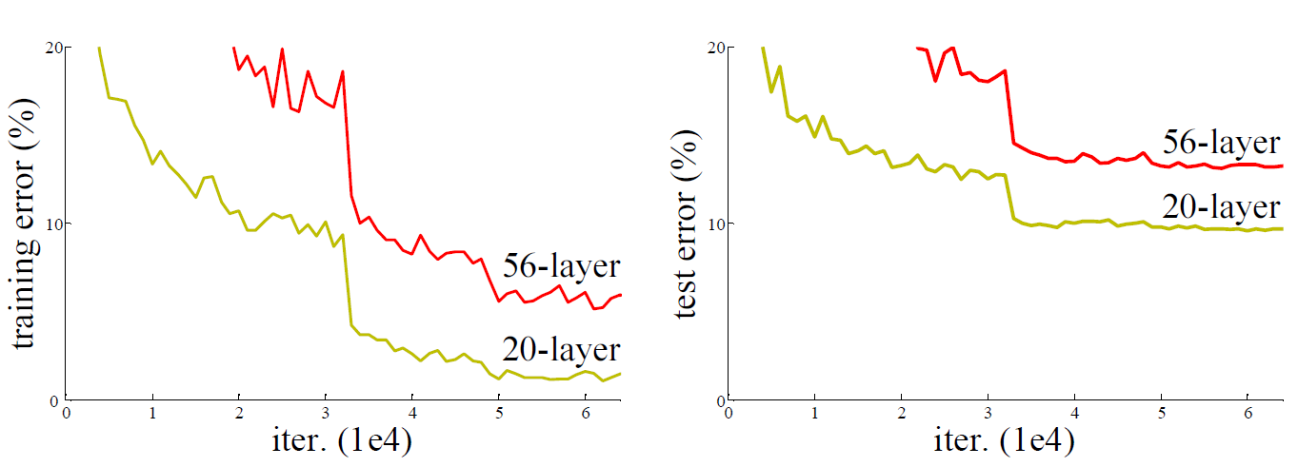
Introduction
General:
- Increase in depth of the neural network allows more precise feature learning
- Makes it perform better, generalize better with low loss
Actual:
- Too deep network actually increased the error rate.
01
02
03
04

Slide 6
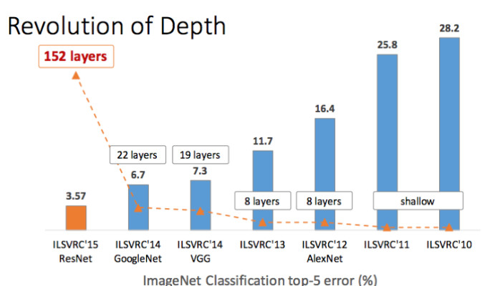
Introduction
Conclusion:
- Too deep network is hard to optimize
- Solution is deep residual learning
01
02
03
04

Slide 7
CNN & VGGnet

Slide 8
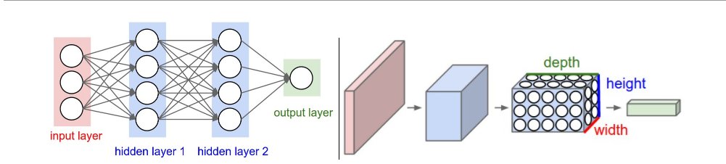
CNN
Convolutional Neural Network
01
02
03
04

Slide 9
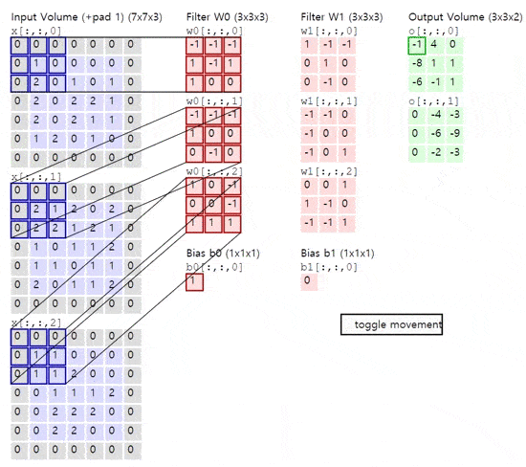
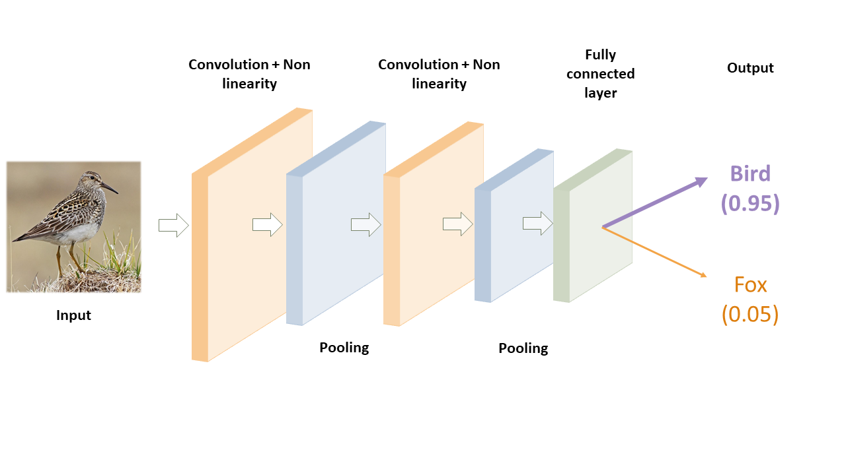
CNN
01
Convolution layer
Pooling layer
Fully connected layer
02
03
04

Slide 10
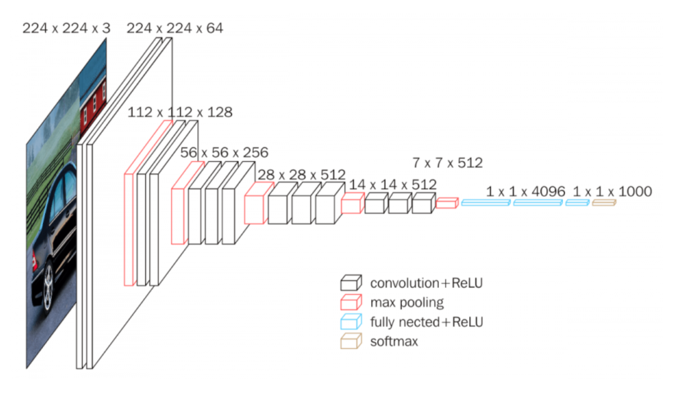
VGGnet
Process:
1) Input into convolutional layer,
2) Increase amount of filters,
3) Downscale with smaller filter size
4) stack up
Result:
- More features learned more and more
01
02
03
04

Slide 11
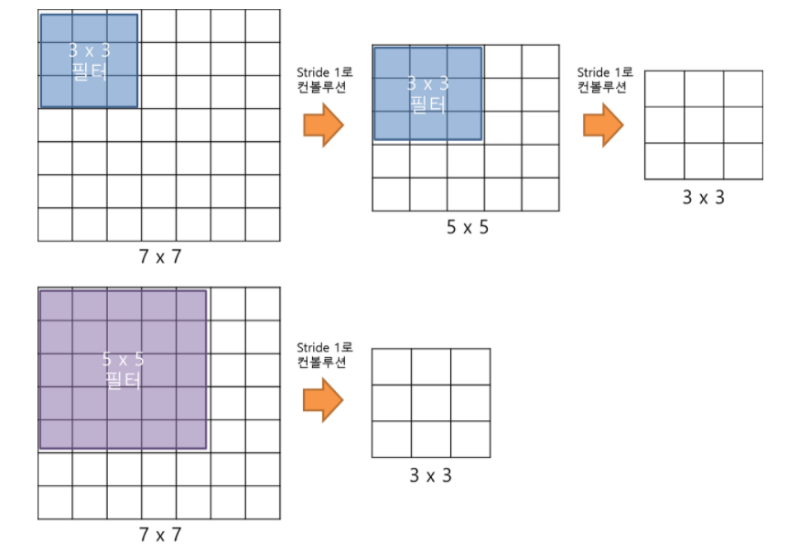
VGGnet
Explanation:
Problem:
- Accuracy shows that not all systems are similarly easy to optimize
* Need to consider a shallower architecture with characteristics of deeper network *
Amount of parameters:
2 x (3x3) = 18
1 x (5x5) = 25
01
02
03
04

Slide 12
Resnet
Point:
- Instead of learning every weight parameters for the newly added layer, stack the residual block and learn the residual information while taking the previous information ahead.

Slide 13
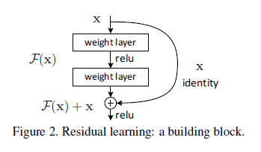
Residual Block
Residual block:
- Block that consists of convolutional layers
- The original mapping is recasted into F(x)+x.
- In normal, y = F(x, {Wi}) + x
- F is flexible, but not single
Advantage:
- Easier to optimize the residual mapping
than to optimize the original,
unreferenced mapping.
01
02
03
04

Slide 14
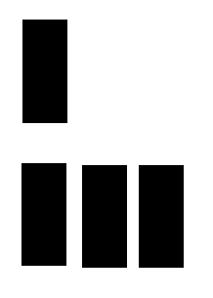
ResNet
Output: x
ResNet:
- Stacking up these residual blocks
- Residual function’s output will be close to zero
- In advance, deeper network is created
01
02
Residual block
Output: x + F(x)
03
Identical Residual block x3
04
F(x)

Slide 15
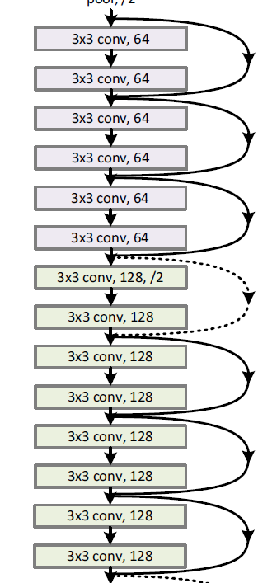
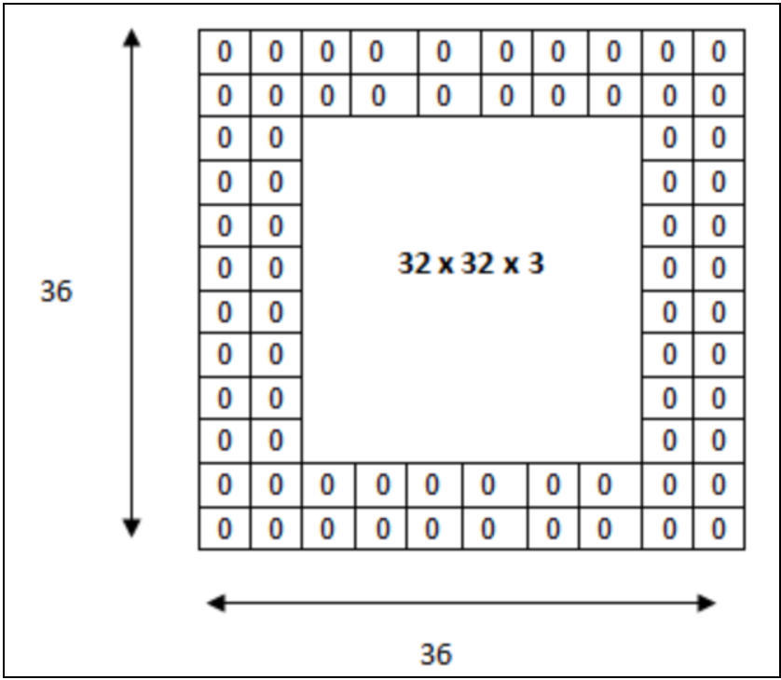
Shortcut connection
Shortcut connections:
- Perform identity mapping and add at the end of the block.
- Shortcut connections require neither extra parameter
nor computational complexity.
- Entire network can still be trained by SGD with backpropagation,
- If the residual output’s dimension does not correspond to
residual block’s input, we have 3 options:
A) Add zero-padding to the output.
B) Perform linear projection,
when dimensions don’t match (doted line)
C) Perform linear projection for every single
shortcut connection
01
02
03
04

Slide 16
Implementation
&
Comparison

Slide 17
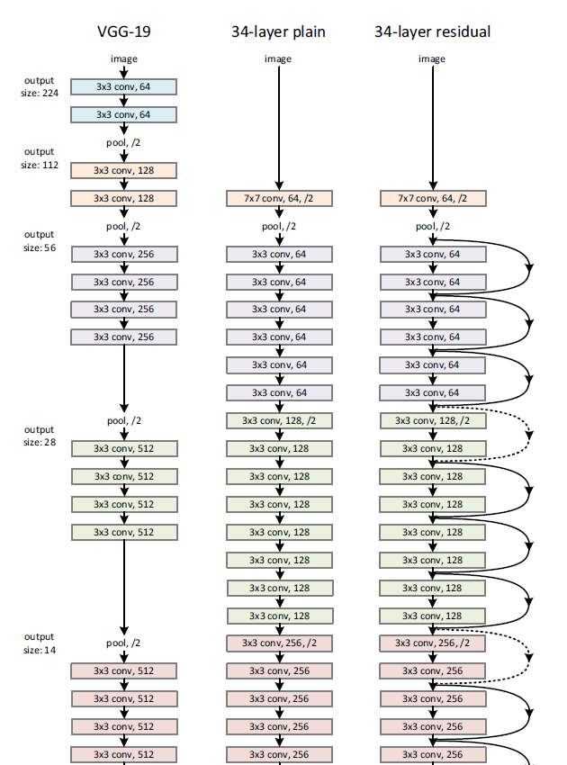
Architecture
Image:
- 224x224 crop is randomly sampled from an image or its
horizontal flip,
Optimization:
- Batch normalization after each convolution and
before activation
- Used He initialization,
- Used SGD with a mini-batch size of 256.
- The learning rate starts from 0.1 and is divided by 10 when the error plateaus
- Trained for up to 60x10^4 iterations.
- Weight decay of 0.0001 and a momentum of 0.9.
- No dropout
01
02
03
04

Slide 18
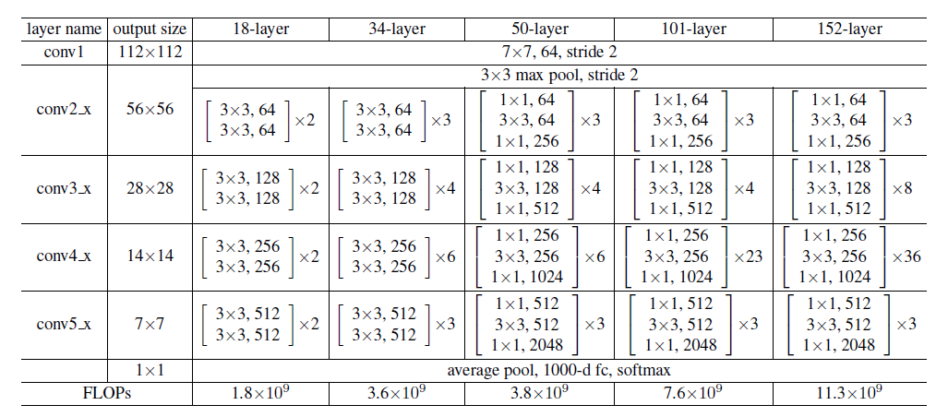
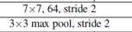
Architecture
Plain:
- The convolutional layers mostly have 3x3 filters
- Down sampling directly by convolutional layers
that have a stride of 2.
- The network ends with a global average pooling layer
and a 1000-way fully-connected layer with softmax.
03
Residual:
- The baseline architectures are the same as the above plain nets
- Shortcut connection is added to each pair of 3x3 filters
04

Slide 19
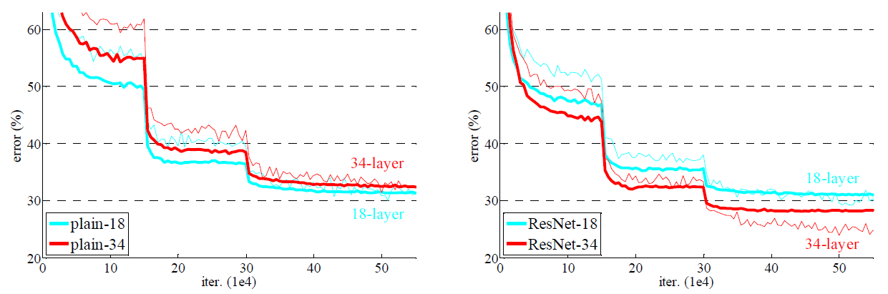
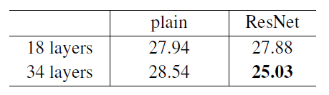
Comparison
Results:
i) Plain:
- Deeper 34-layer plain net, higher error rate than the shallower 18-layer plain net.
- Optimization unlikely to be caused by vanishing gradients because,
plain networks are trained with batch normalization.
ii) Residual:
- Deeper 34-layer ResNet, lower error rate than the shallower 18-layer ResNet
01
02
03
04

Slide 20
Comparison
Advantage of ResNet:
- In this case, the ResNet eases the optimization by providing faster convergence at the early stage.
- Deeper network
- ResNet has fewer filters and lower complexity than VGG nets.
- 34-layer ResNet has 3.6 billion FLOPs, which is only 18% of VGG-19 (19.6 billion FLOPs).
* FLOPs is used to compare the complexity in deep learning.
01
02
03
04

Slide 21
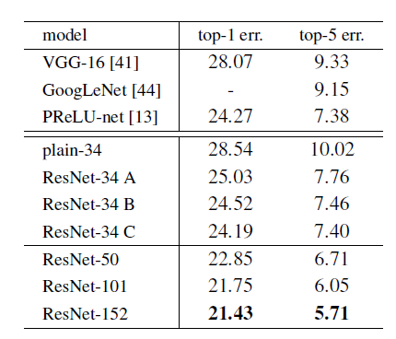
Comparison
Among option A, B, C in shortcut-connection, which will be efficient?
i) Comparison:
- All three options are better than the plain.
- ‘B’ better than ‘A’, because the zero-padded dimensions
in ‘A’ have no residual learning.
- ‘C’ better than ‘B’, but requires extra parameter for
projection shortcuts.
ii) Conclusion:
- The small differences among A,B,C indicates that projection shortcuts
are not essential for main problem.
- To reduce memory/time complexity and model sizes we normally use B
01
02
03
04

Slide 22
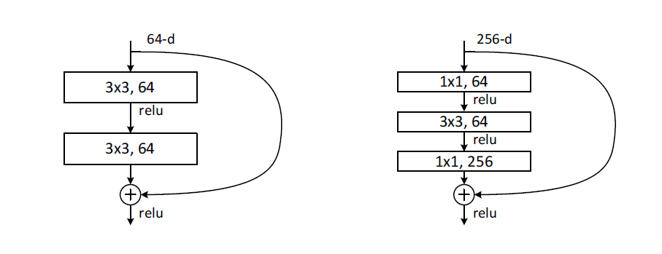
Improvement
Bottleneck architect:
- To reduce the training time, we modify the block
as a bottleneck design.
- We use a stack of 3 layers instead of 2, as a block
- Three layers are 1x1, 3x3, and 1x1 convolutions
- 1x1 layers are responsible for reducing and
increasing (restoring) dimensions.
- The 3x3 layer gets smaller input/output dimensions.
* Identity shortcuts are particularly important for restraining the complexity of the bottleneck architectures *
If the identity shortcut is replaced with projection, the time complexity and model size are doubled as the shortcut is connected to the two high-dimensional ends. So identity shortcuts lead to more efficient models for the bottleneck designs.
01
02
03
04

Slide 23
Improvement
Using bottleneck block:
i) 50-layer ResNet:
- Replaced with 3-layer bottleneck block
- Used option B for increasing dimensions.
- This model has 3.8 billion FLOPs.
ii) 101-layer and 152-layer ResNets:
- Used more 3-layer blocks
- The 152-layer ResNet (11.3 billion FLOPs)
still has lower complexity
than VGG-19 nets (19.6 billion FLOPs).
01
02
03
04

Slide 24
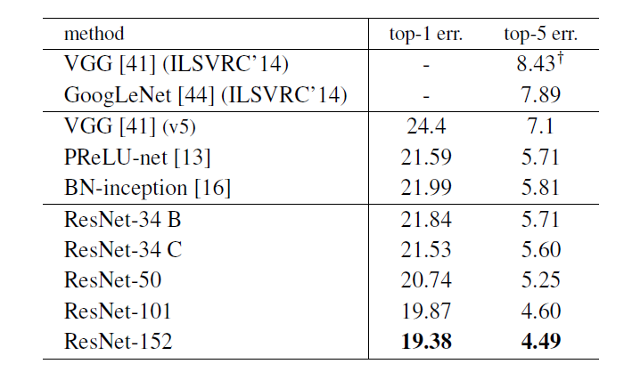
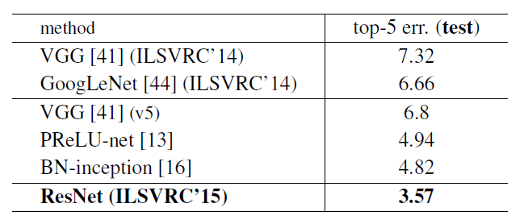
Analysis
Analysis of accuracy
- The 50/101/152-layer ResNets are more accurate than
the 34-layer ones
- We do not observe the degradation problem
- Accuracy increased with increased depth.
- Ensemble model with combination of
six models of different depth led to 3.57% top-5 error
01
02
03
04

Slide 25
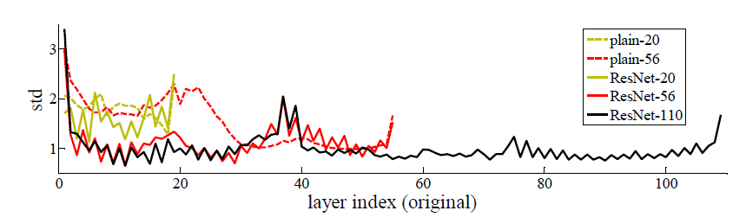
Analysis
Analysis of Layer Responses:
- Shows the standard deviations (std) of the layer responses.
- The responses are the outputs of each 3x3 layer, after BN and before other nonlinearity (ReLU/addition).
- ResNets have smaller responses than plains.
- These results support that the residual functions might be generally closer to zero
01
02
03
04

Slide 26
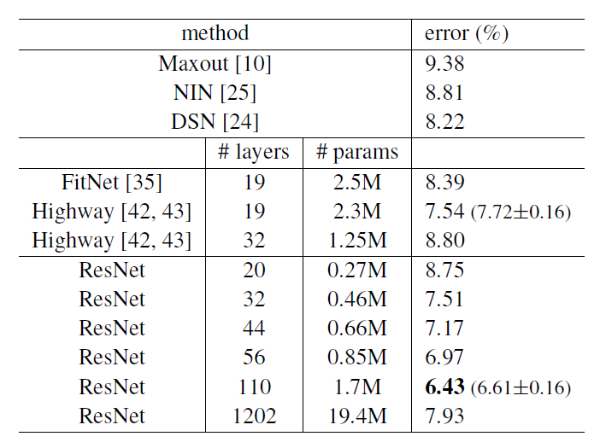
Analysis
Further research (exploring over 1000 layers)
i) 1202-layer network:
- Its test error not bad with 7.93%
- The 1202-layer network’s error rate
higher than 110-layer network,
ii) Conclusion:
- This is because of overfitting.
- The 1202-layer network is unnecessarily
large (19.4M) for this small dataset.
- In this paper, no maxout/dropout used.
- Combining with stronger regularization
may improve results
01
02
03
04

Slide 27
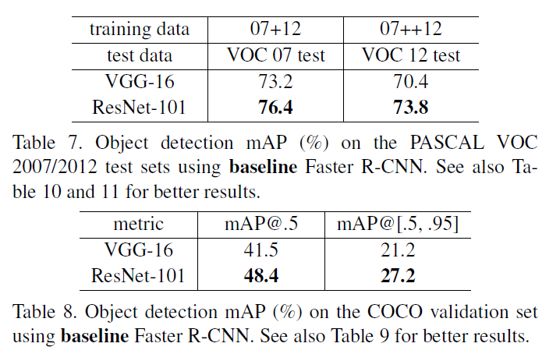
Analysis
Object Detection on PASCAL and MS COCO
- With adaptation of Faster R-CNN as the detection method and VGG-16 replaced with ResNet-101, accuracy improved.
01
02
03
04

Slide 28

Experiment

Slide 29
Procedure
01
Procedure
1) Comparison between shallow CNN net & deep CNN net
2) Comparison between same depth of CNN net & Resnet
02
03
04

Slide 30
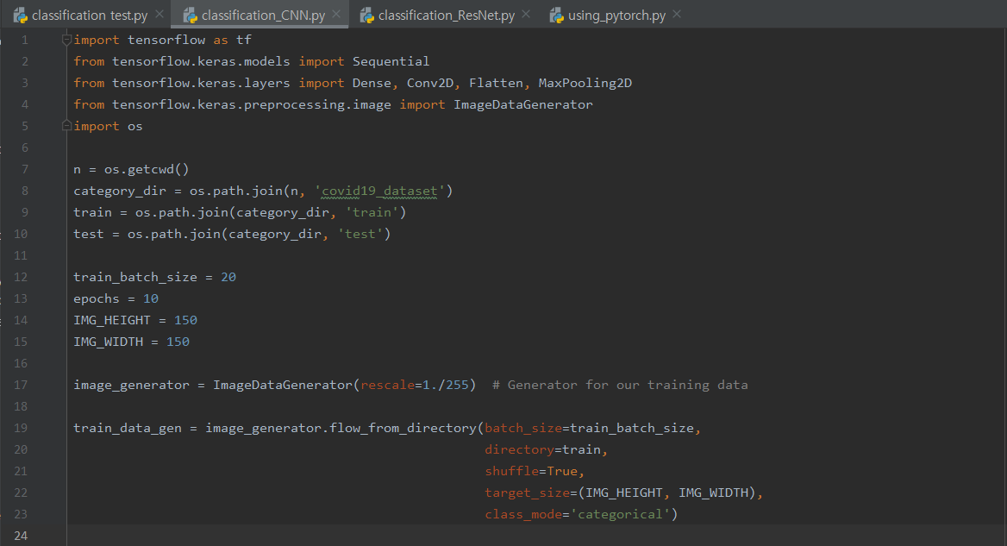
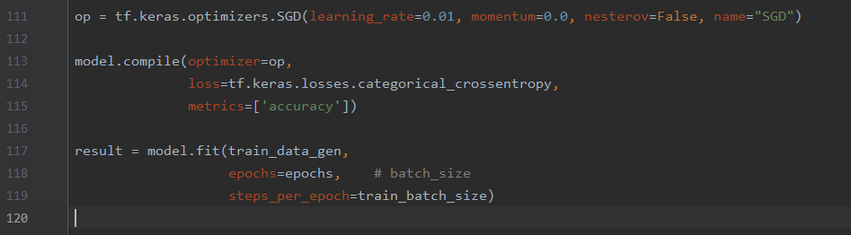
Code snippet
Image preprocessing
01
02
03
Optimizer
04

Slide 31
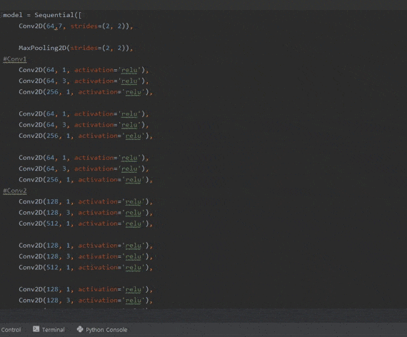
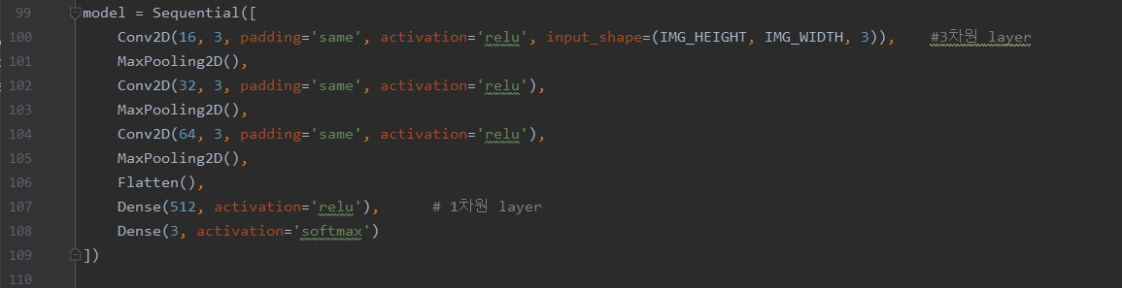
Code snippet
Model
5-layer CNN model
50-layer CNN model
01
02
03
04

Slide 32
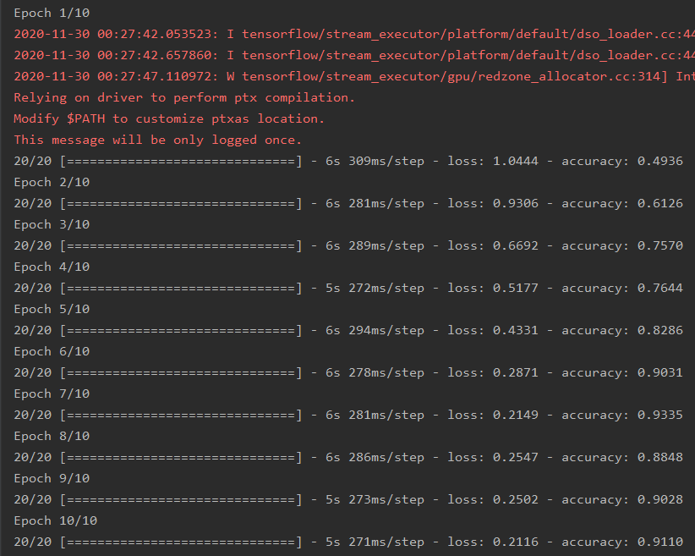
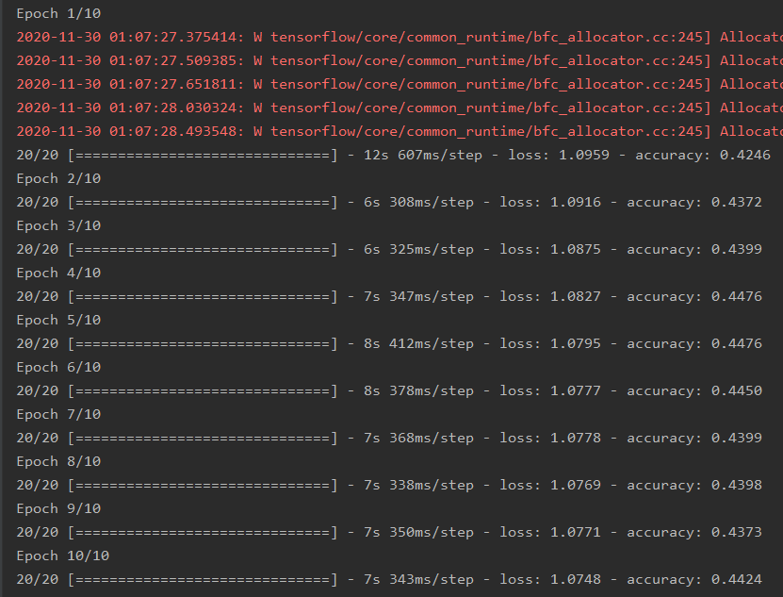
Comparison between shallow CNN net & deep CNN net
5-layer CNN model
50-layer CNN model
01
02
03
04

Slide 33
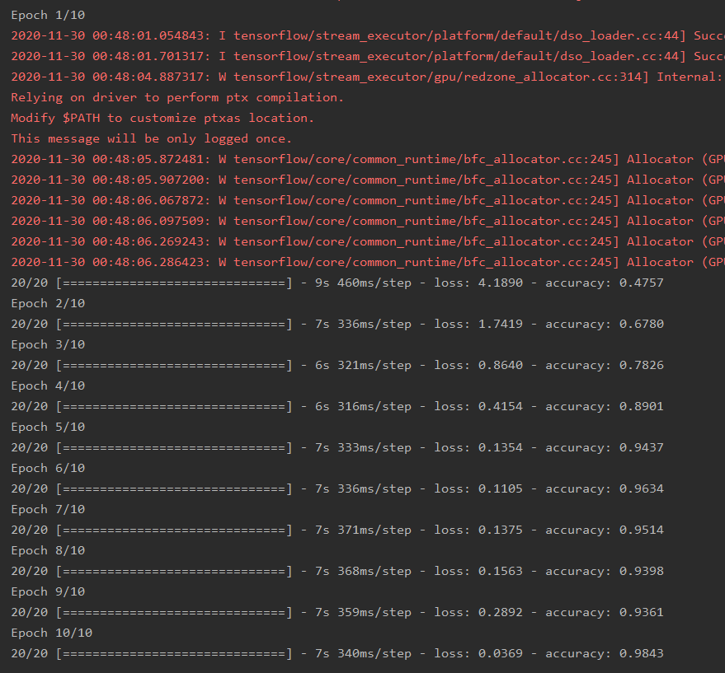
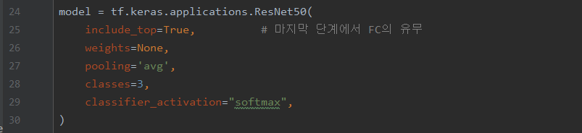
Code snippet
50-ResNet model
01
02
50-ResNet model accuracy
03
04

Slide 34
Result & Conclusion
* Deep residual nets are easy to optimize
&
Can easily increase accuracy
by increasing depth *
01
02
03
04

Slide 35
Reference

Slide 36
Reference
CNN:
https://cs231n.github.io/convolutional-networks/
https://methodsblog.com/2019/11/13/understanding-deep-learning/
http://taewan.kim/post/cnn/
VGG-16:
https://www.theaibuddy.com/post/cnn-architecture-series-hands-on-with-vgg-16
https://bskyvision.com/504
ResNet:
http://cs231n.stanford.edu/slides/2017/cs231n_2017_lecture9.pdf
https://www.youtube.com/watch?v=C6tLw-rPQ2o
C4W2L04 Why ResNets Work – YouTube
https://stackoverflow.com/questions/58498651/what-is-flops-in-field-of-deep-learning
Keras, ResNet50:
https://keras.io/api/applications/resnet/

Slide 37
Thank You

